Slide 1
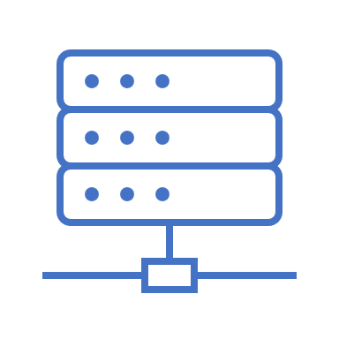


Server
Robot
App

